Slide 1
Accept one another to glorify god
Romans 15:4-13

Slide 2
Romans 15:4-13
Gentiles = all nations or people groups
For whatever was written in former days was written for our instruction, that through endurance and through the encouragement of the Scriptures we might have hope. ⁵ May the God of endurance and encouragement grant you to live in such harmony with one another, in accord with Christ Jesus, ⁶ that together you may with one voice glorify the God and Father of our Lord Jesus Christ. ⁷ Therefore welcome one another as Christ has welcomed you, for the glory of God. ⁸ For I tell you that Christ became a servant to the circumcised to show God's truthfulness, in order to confirm the promises given to the patriarchs, ⁹ and in order that the Gentiles might glorify God for his mercy. As it is written,
“Therefore I will praise you among the Gentiles, and sing to your name.”
¹⁰ And again it is said,
“Rejoice, O Gentiles, with his people.”
¹¹ And again,
“Praise the Lord, all you Gentiles, and let all the peoples extol him.”
¹² And again Isaiah says,
“The root of Jesse will come, even he who arises to rule the Gentiles; in him will the Gentiles hope.”
¹³ May the God of hope fill you with all joy and peace in believing, so that by the power of the Holy Spirit you may abound in hope.

Slide 3
Romans 15:4-13
Ultimate Purpose: Glorify God
How: Accept One Another
Where…

Slide 4
Ultimate purpose: Glorify god
The text says…
that together you may with one voice glorify the God and Father of our Lord Jesus Christ. (vs 6)
for the glory of God (vs 7)
in order that the Gentiles might glorify God for his mercy (vs 9)
Rom 11:36
For from him and through him and to him are all things. To him be glory forever. Amen.
What glorify means (e.g., Jn 8:54)

Slide 5
Ultimate purpose: glorify god
Inwrought Cross= giving like God
Pervasive theme in the Bible
“It is the Father’s ultimate intention that He might have a vast family who embrace the inwrought Cross which they have seen reflected from His paternal heart.” Ultimate Intention (Fromke 1963, p.59)
God’s “purpose in all of history is to uphold and display his glory for the enjoyment of his redeemed people from all the nations.” Let the Nations Be Glad (Piper 2003, p.52)
“The great end of God’s works, which is so variously expressed in Scripture, is indeed but ONE; and this one end is most properly and comprehensively called THE GLORY OF GOD.” Jonathan Edwards (ibid p.28)

Slide 6
Ultimate purpose: Glorify god
Shift mindset to God’s
All of life is about God’s glory.
God-centered thinking
God’s point of view
Why? (Psalm 96)
He is worthy
He is glorious and full of splendor
He is to be feared
It gives us joy to glorify God (Ps 96:11-12)

Slide 7
Joy to serve
Chad & Janeene Mankins
Papua New Guinea
Planting church, translating Bible

Slide 8
How: Accept one another
Romans 15:7 Accept one another, then, just as Christ accepted you, in order to bring praise to God. (NIV)
Mark 9:50 “Salt is good, but if the salt has lost its saltiness, how will you make it salty again? Have salt in yourselves, and be at peace with one another.”
Mark 9 story

Slide 9
Accept one another
What “accept” or “welcome” (ESV) means
One who eats meat or abstains (immediate context)
Jewish and Gentile believers (Rom 1-12)
Within the local fellowship
Tolerate differences of opinion
Forgive
Commit 100% (do the same in marriage!)
Result is joy

Slide 10
Accept one another
Other churches
Neighbors, colleagues, school, BSF, etc.
“God has used different men and women and movements—not to corner the truth but to recover and herald truth to the upbuilding of the entire body of Christ. Every major awakening has centered in a major recovery of a truth necessary to mature and balance other aspects of truth.” Ultimate Intention (Fromke 1963, p.9)

Slide 11
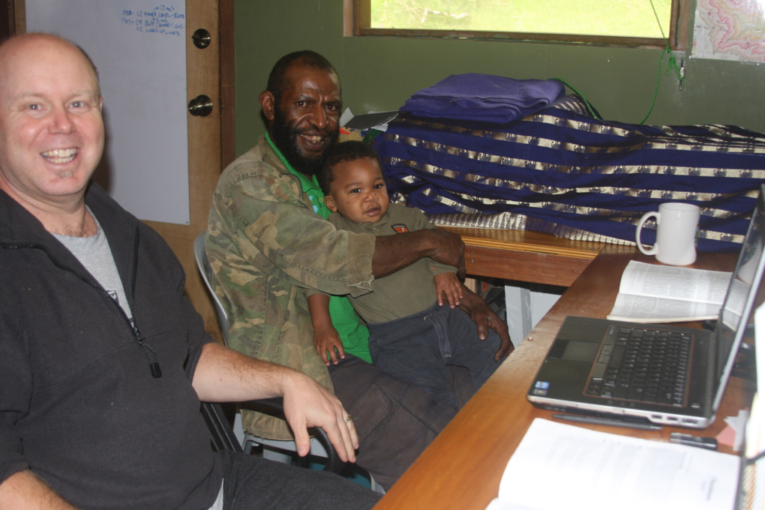
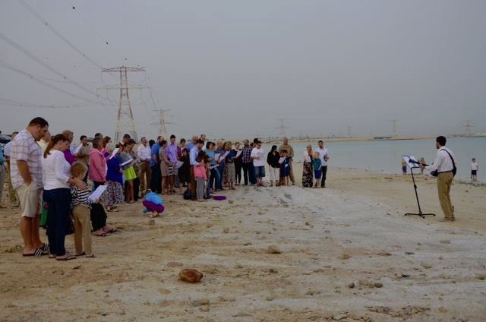
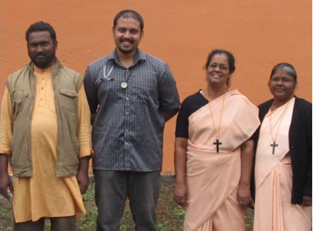
Where…
Other cultures
Jews & Gentiles
in 1st Century Rome
Ferguson… San Jose
Sihora Clinic… International Churches
All the earth to rejoice in and glorify God
Rejoice, O Gentiles, with his people (vs 10; Deut 32:43)
“The ultimate goal of God in all of history is to uphold and display His glory for the enjoyment of the redeemed from every tribe and language and people and nation.” Let the Nations Be Glad (Piper, p.231)
“God’s self-exaltation and our jubilation are one”(ibid)
“The goal… is the gladness of the peoples in the greatness of God.” (ibid)
#AllglorytoGod

Slide 12
All the earth
Hope
For whatever was written in former days was written for our instruction, that through endurance and through the encouragement of the Scriptures we might have hope. (vs 4)
May the God of hope fill you with all joy and peace in believing, so that by the power of the Holy Spirit you may abound in hope. (vs 13)

